Slide 1
Indic photo-ocr
Group members –
Chaitanya singh (b24cs1088)
Pawan kumar (b24bb1024)
Varnit sharma (b24ee1085)

Slide 2
DELIVERABLES –
Aim : Our aim on this project was to test the IndicPhotoOCR system using our own dataset.
Data collection : We collected diverse scene images containing natural text in different Indian script.
We collected 61 images containing “Hindi” and “English” scripts and manually annotated
them by typing the visible text .
Then the output of the model was compared to our annotation in order to calculate metrics like WRR(Word Recognition Rate ) and PRF(Precision Recall and F1 score).
In certain cases words recognised by the model was correct but giving uppercase and lowercase issues ,so for evaluation, we used two approaches: one in which case differences were ignored and uppercase/lowercase variations were treated as equivalent, and another in which case sensitivity was enforced.

Slide 3
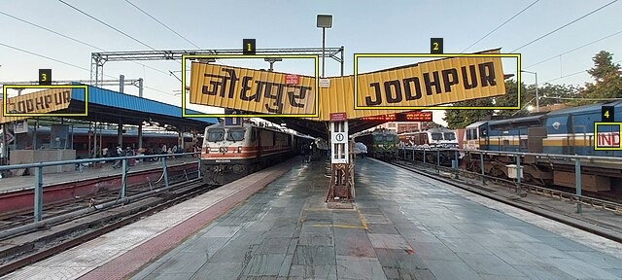
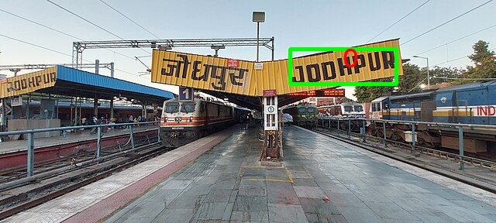
Comparison between model output and dataset image :
Dataset Image :
Model Output :
WRR for Hindi – 0/1 = 0
WRR for English - 1/3 = 0.33
Misclassification : Words that have been wrongly annotated by the model or not being annotated but annotated by us .
In the given image , 3 words has been misclassified by the model .

Slide 4
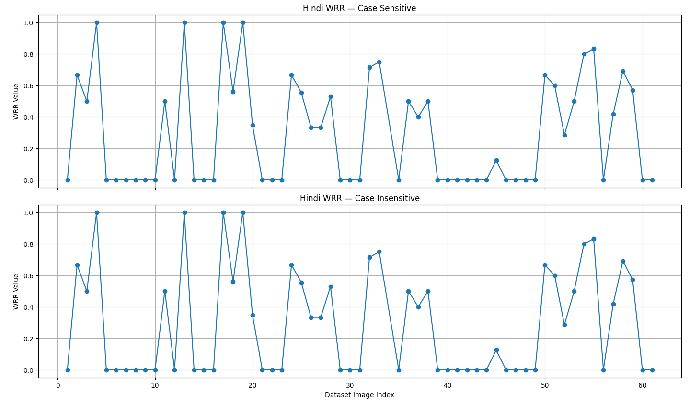
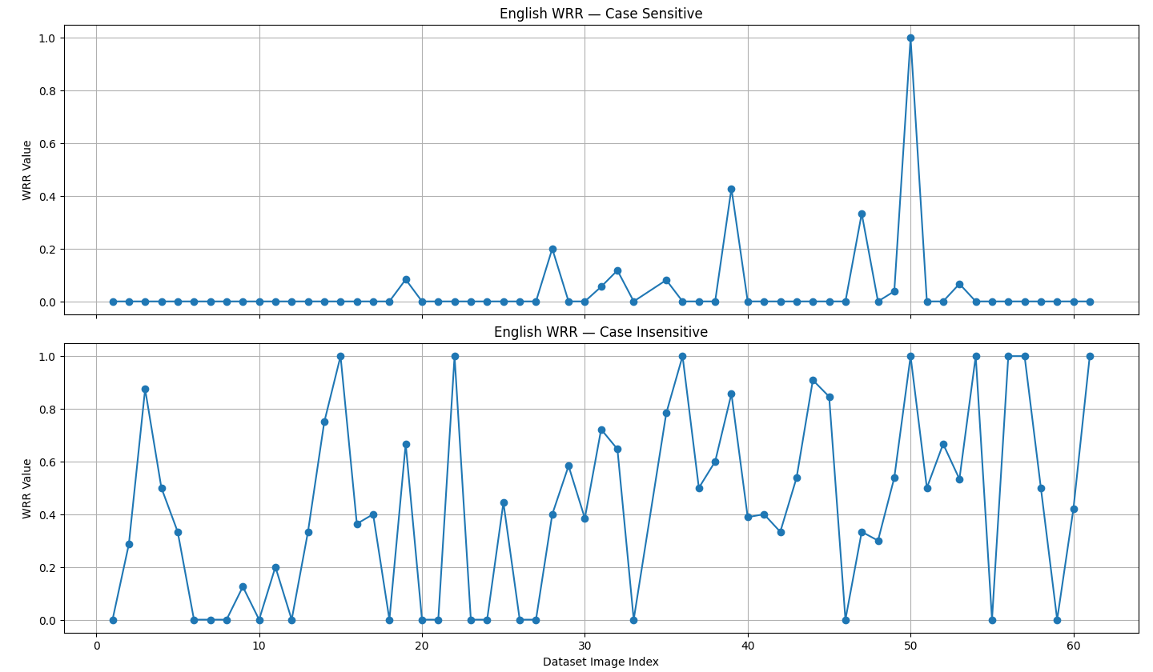
PRF for Hindi And English :
Hindi
English
• Hindi WRR: 28.91% • English WRR: 4.01% (for case sensitive)
: 43.27% (for case insensitive)

Slide 5
Acknowledgement
We would like to express our sincere gratitude to Prof. Anand Mishra for his valuable guidance, continuous support, and encouragement throughout the development of this INDIC-OCR project.
His insights and expertise have been instrumental in shaping the direction and quality of our Work. We are also deeply thankful to our mentor, Mr. Anik De, for his constant assistance, constructive feedback, and mentorship at every stage of the project. His patience and detailed explanations helped us understand complex concepts and complete the project successfully.
Finally, we would like to acknowledge the support of our peers and everyone who contributed directly or indirectly to this project. Their cooperation and motivation played an important role in bringing this work to completion.

Slide 6
Thank You

